Slide 1
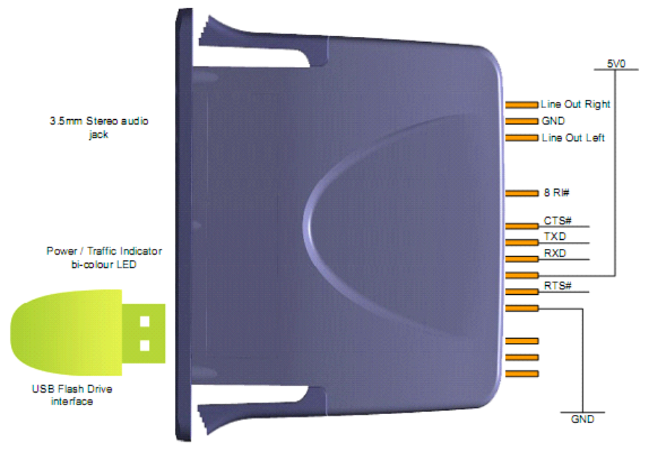
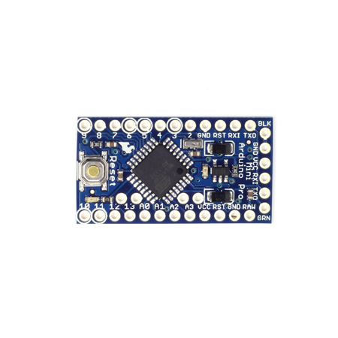
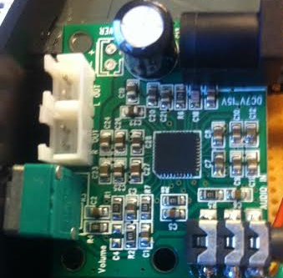
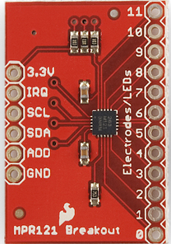
Arduino
Vmusic
Amplifier
TouchSensor
Speakers

Slide 2
Key
= Misc. wires from the Vmusic
= Ground wires (negative)
= Power (positive)
= Transmitting wires
= Receiving wires
= Misc. wires from the touchsensor

